Slide 1
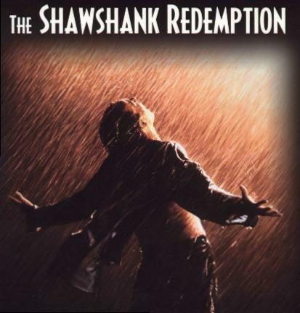
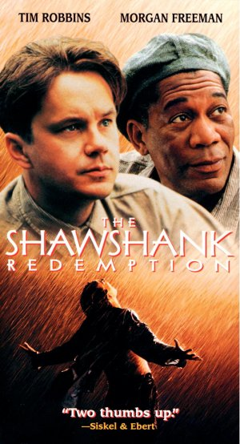
The Shawshank Redemption
Hong Zhang

Slide 2
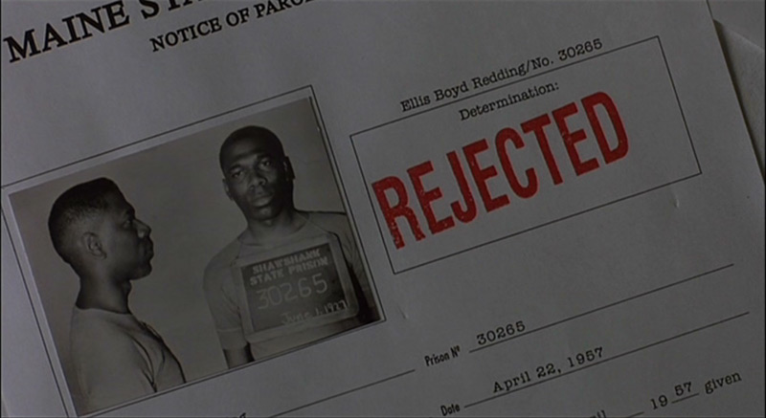
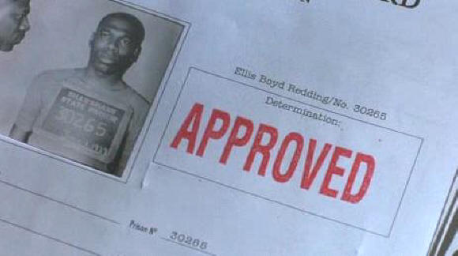
Theme
Institutionalization
Many prisoners have been in the prison for so long that they have been institutionalized, which means the only life that they know is the one within the prison walls.

Slide 3
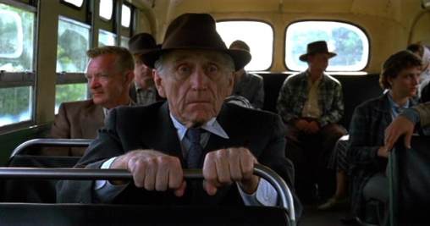
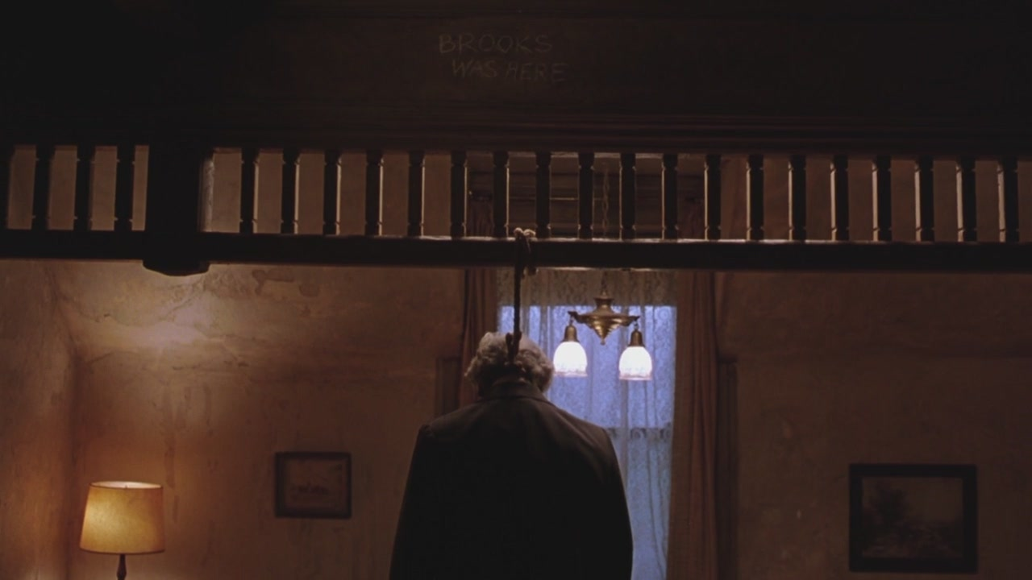
Theme
Institutionalization
Ex: Brooks lived most of his life in the prison, so when released he does not know how to live in the outside world. Things have changed so much while he was in prison and he even thinks of crimes he could commit in order to be thrown back into prison. He eventually commits suicide because he cannot handle life in the real world.

Slide 4
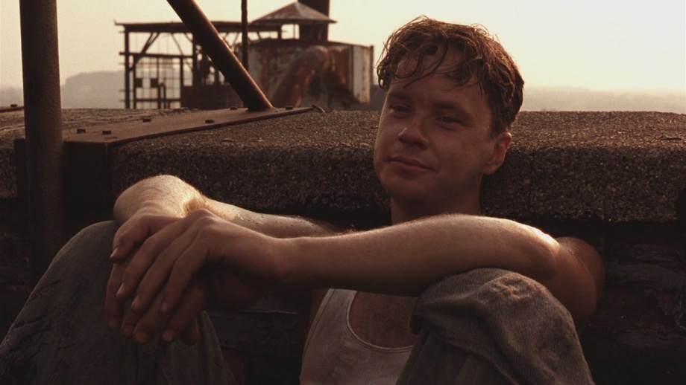
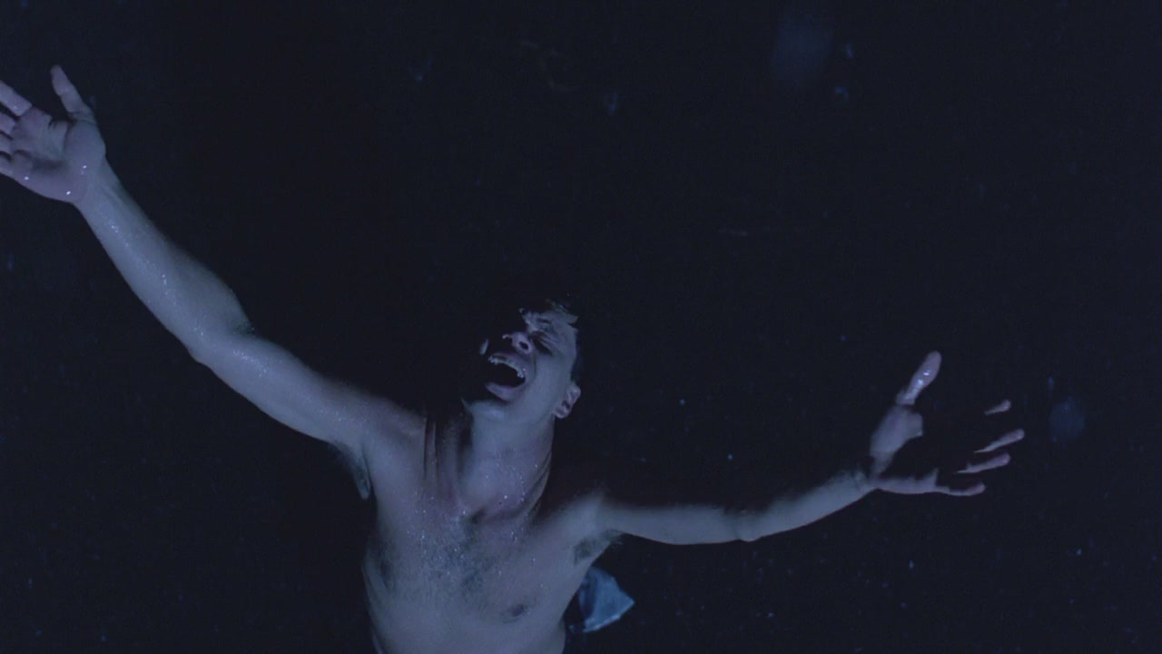
Theme
Hope
The Power of Hope: drive the inmates and gives them the will to live. Andy’s drive to maintain his own sense of self-worth and freedom is what prevents him from dying of frustration in solitary confinement.

Slide 5
The Rooftop Scene
COLOUR/ LIGHTING
Bright lighting and colour symbolises freedom
The guard’s faces are in shadow while the inmates are working.
Grass outside the prison is bright green – this shows a juxtaposition of the two settings – the inside and the outside
Prisoners can see green from the rooftops (hope, freedom) contrasted with the grey walls of the prison walls and grounds (institutionalisation, power corruption)
Sun shines on the inmates’ faces while they drink beer – freedom and the guards are in shadow in the distance with the prison walls behind them.
Can see lots of blue sky in the background, almost to the horizon, inmates feel a sense of freedom on the rooftops.

Slide 6
The Rooftop Scene

Slide 12
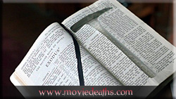
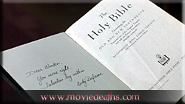
Symbols
The Holy Bible: To the warden, the Bible is sacred and to be followed at all times, so it is a rule book.
To Andy he hides his rock hammer in the Bible going against the rules completely.
Embroidered “His Judgment Cometh and that Right Soon” a symbol of the warden’s faith, but ironic because his own judgment will come when Andy anonymously tells on him.

Slide 13
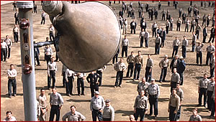
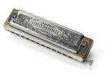
Symbols
The music symbolizes hope and especially Andy's hope that he will someday be free and living on his own again. The music can be in his heart and mind and the warden cannot take that away from him.
The harmonica is a symbol of harmony and it shows the harmonic relationship between Andy and Red because Andy gives it to Red. It also symbolizes hope.

Slide 14
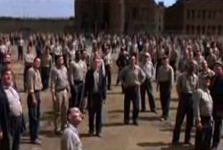
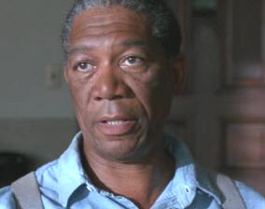
Technical Shots
Aerial shot: A shot taken from the air which is often used for large crowds or to emphasize how expansive and large something is.
Close up: The camera focuses in very closely upon a person or object to emphasize the importance of an expression or meaning of an object.

Slide 15
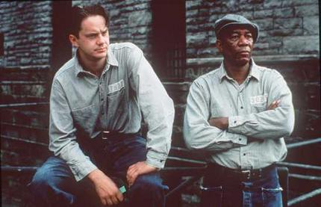
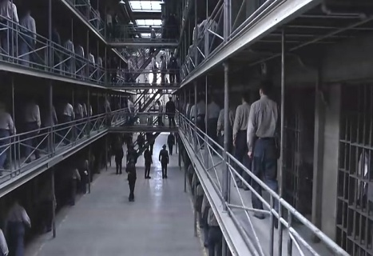
Technical Shots
Two Shot: Shows the relationship of two people by body language and their discussion when it is only them in a shot.
Long Shot: This type of shot emphasizes size and the enormity of a setting. It also can emphasize the quantity like in this case the amount of prisoners Shawshank holds.

Slide 16
Opening scene
Andy’s ambivalence
Sound track song reflects Andy’s mood of disillusion and fatalism.
Car and clothes suggest 1946. Red later says that “Andy came to Shawshank prison in 1947 for murdering his wife and the fella she was banging.”
Andy is depressed because of the failure of his marriage, but the film gains a lot of its appeal by not telling us things such as this for some time. As with the poster of Rita Hayworth.
Immediately, therefore, suspense is a hallmark of this thriller.
The darkness mirrors his mood. The shattering of the bottle= the shattering of his dreams.
The trail
CUT and AURAL BRIDGE to the courtroom without completing the previous action, leaving us suspended in mid-plot- the scene outside the cabin is intercut with the trail scene.

Slide 17
Opening scene
Having found out about the affair, Andy angrily refused to give her a divorce an Reno, Nevada.
V.O from the trail melds the three scenes together: the two having steamy sex, Andy pondering in the car and the courtroom: smooth CROSS-CUTTING giving variety in story telling.
Andy claims to have thrown the gun into the Royal River on his way home- “I feel I have been very clear on this point”
LOW ANGLE CU of the prosecutor, raised voice and leaning forward, accentuating his menace.
Throughout a piano tinkles with suspenseful strings, heightening the tension.
CU LOW ANGLE of judge heightens .his forbidding demeanour; his words come slowly and precisely: “you strike me as a particularly icy and remorseless man, Mr Dufrensne. It chills my blood just to look at you.”

Slide 18
Opening scene
HIGH ANGLE CLOSE on Andy , stressing his helplessness before the power of the law. “By the power invested in me by the state of Maine, I hereby order you to serve two life sentences back to back, one for each of your victims. So be it!”
His gavel thumps down in symbolic representation of the law’s awesome force, Andy closes his eyes in hopeless resignation and the screen goes black, representing the awful fate that awaits him.
The audience is left deliberately in the dark re Andy’s guilt; indeed, we probably share the judge’s distaste for this seemingly cold, unemotional man. A PAN across the jurors suggests they do too.

Slide 19
Arrival at Shawshank
Institutionalisation
Red steps into the prison yard and we got our first look at Shawshank prison. Grey walls.
“How did it go?” asks one inmate.
“Same ol’ shit, different day.”
“I’m up for rejection next week.”
Red begins the V.O narration that anchors the film. He is the prison’s respected retriever.
Prison sirens blast as a ritualistic prison event is heralded – the arrival of fresh, new prisoners in a drab-grey school bus.
An aerial (helicopter) shot moves up from the arriving bus, ascends the main tower od the prison and peers down into the prison courtyard where ant-like prisoners swarm towards the main gate to gawk and jeer while the new arrivals (fresh meat) disembark.

Slide 20
Arrival at Shawshank
A sweeping helicopter travelling shot of the approach to the prison and the prison yard behind reveals the massive Gothic Victorian towers and high walls, the immense area of the compound, in comparison with which humans are puny and insignificant.
This shot is highly symbolic, reflecting how it is impossible to escape, how crushing the system is. The system is awesome and forbidding.
Cellos and violas reinforce the sombre atmosphere.
Subsequent shots emphasise the intimidating nature of the surround- steel mesh fencing, grey walls, a bleak sky, ruthless guards, gates guarded, tight security, guards up high with machine guns- while in contrast, green fields and trees lie beyond.
Jeering inmates rattle the steel mesh fencing like caged animals in the zoo. They are beasts.
Captain Hadley eyeballs every prisoner as they step off the bus, chained to each other.
The crude prison vocabulary makes the scene more authentic, suggests the brutality and inhumanity prisoners show to each other and makes for an original, fine script.

Slide 21
Arrival at Shawshank
“I didn’t think much of Andy the first time I set eyes on him. Looked like a stiff breeze would blow him over. That was my first impression.”
Statement implies that something will happen to change Red’s opinion, so creating tension.
Andy looks up and the camera is his eyes: A POV< LOW ANGLE SHOT. The enormity of the walls is emphasised and only a small patch of sky can be seen, which is grey. Strong feeling of entrapment.
The main characters are quickly characterised: Heywood his a slight stammer and sweeping blonde hair. Hadley looks as if he would be at home in a Nazi concentration camp.

Slide 22
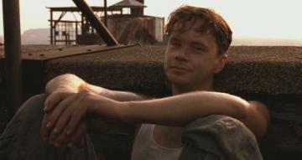
The Rooftop - Freedom
The background of the prisoners is offset by the green, bright tones of the outside of Shawshank – this is juxtaposed with the grey of the inside of the prison an the background of the guards.
Andy ‘tricks’ Hadley and reveals him as an unintelligent thug

Slide 23
The Rooftop - Freedom
This is an uplifting scene as we watch the harsh, unbreakable walls of Shawshank dissolve away for the men as they sit in the sun and drink cold bottles of beer.
Andy sits by himself (in the light) to show that he is different. He retains hope and wants to retain a sense of freedom. This is the first time he shows emotion – looks content
Red is seen with the guards in the background blurred over his shoulder – there is always the ‘institutionalised’ mentality – Andy offers hope

Slide 24
The Rooftop - Freedom
This scene is all about giving the prisoners a taste of hope and freedom. Andy is the a leader, offering redemption
“We sat and drank with the sun on our shoulders and felt like free men…We were the Lords of all Creation.”
“You could argue he’d done it to curry favour with the guards…Me? I think he did it to feel normal again, if only for a short while”.
The audience experiences victory with these men.

Slide 25
Aria over the Loudspeaker – Freedom
Irony – ‘The Marriage of Figaro’ (Mozart) about a servant who outwitted his master.
Guards and prisoners alike are stunned and hypnotised by the music as it breaks the routine of prison life. The music transcends the day to day numbness.
A medium shot reveals Andy has the same look on his face as in the ‘Rooftop Scene’. He is allowing them to have some freedom again.

Slide 26
Aria over the Loudspeaker – Freedom
Crane shot of the prisoners in the yard looking at the loud speaker and listening to the music. The whole prison has been moved to a standstill.
The light is resonating through the prison.
Close up of the men’s faces as the camera pans shows that they are in awe of the music. They seem peaceful and at ease

Slide 27
Aria over the Loudspeaker – Freedom
Voiceover:
“I tell you those voices soared. Higher and farther that a person in a grey place dares to dream. It was like some beautiful bird flapped into our drab little cage and made those walls dissolve away. And for the briefest of moments, every last man in Shawshank felt free.” –This statement finishes with a close up of Red – Andy made his taste freedom.

Slide 28
Aria over the Loudspeaker – Freedom
Andy has the same expression on his face as he did on the rooftop.
The abrupt scratch of the music shows a return to the evil of the prison.

Slide 29
The Final Scenes
The dramatic tension reaches an almost certain breaking point when Red is talking about how dejected Andy feels and Heywood reveals he gave him rope – will Andy be like Brooks?
Inmate: “Remember Brooks Hadlen”
Inmate 2: “No. Andy would never do that.”
Red: “Every man has his breaking point.”
Are they wrong to assume Andy would commit suicide?

Slide 30
The Final Scenes
It is appropriate that we see Andy pulling the wool over the Warden’s eyes. Specific moments in this sequence are put in place so that we can decipher pieces of the puzzle – Andy placing the bible and papers in the safe, shining the shoes,
“It’s good having you back Andy. Place wasn’t the same without you”. – the Warden doesn’t recognise who he is up against.
Yet again, lighting and the contrast of light between the Warden and Andy show us good and evil.

Slide 31
Final Scenes
A medium shot of Andy sitting on the bed in his prison reveals that he is calm and appears to be waiting.
A number of close ups reveals Andy reaching for the rope. He holds it in his hands – what is he going to do?
A close up reveals Andy staring at the wall the poster is on.
Zoom in to a close up of Red – “That was the longest night of my life” – Lightening crashes in the background.

Slide 32
Final Scenes
The familiar sound of iron bars and alarms sends the routine of the prison underway.
A close up of the guard reveals his shock – “Oh my holy God” – blasphemy

Slide 33
Final Scenes
Cut to Warden Norton revealing Andy’s shoes in his shoebox – The viewer now thinks seriously about what is going on. Piece by piece the puzzle is put back together.
Tilt to a close up of the Warden trying to figure out what is happening and then right on cue, the siren rings out – just as it did when Andy arrived
The Warden is incensed at having been tricked and can’t figure out what has happened – Andy has outsmarted him

Slide 34
Final Scenes
A close up of Raquel Welch draws our attention to the poster – all through the movie we’ve been drawn to the changing women on Andy’s wall but have never questioned it.
The Warden throws a chess piece at the poster and we hear it carry on through the wall.
A zoom out reveals the tunnel through which Andy escaped and the Warden, Red and Hadley all in awe of the discovery.
Cut to police cars and sirens rushing to the prison. Men wading through the water

Slide 35
Final Scenes
Voiceover: “In 1966 Andy DuFresne escaped from Shawshank Prison.”
Zoom in to a close up of the rock hammer worn to the nub: “I remember thinking it would take a man six hundred years to tunnel through the wall with it. Old Andy did it in less than twenty.”
Flashback – Cut to a close up of Andy scratching his name in the wall. Reveals that the wall comes away easily.

Slide 36
Final Scenes
Voiceover: “Andy loved geology. I imagine it appealed to his meticulous nature…Geology is the study of pressure and time. That’s all it takes really – pressure and time…That and a big god damned poster.”
There are many references to earlier things Red has said, this is so we can see the intricate detail that has gone into the plot of this movie. Aspects have been introduced and then reinforced later – the puzzle becomes clearer.

Slide 37
Final Scenes
Voiceover: “I guess after Tommy was killed, Andy decided he’d been here just about long enough.”
The voiceover is important because we can make links and Red points them out. He also give just cause for Andy’s actions. He is our guide on this journey – the story of Andy’s life in Shawshank.
In these scenes, Andy seems confident, like he knows something we don’t. He has outwitted the Warden and this is just an added bonus to his freedom – It is his revenge

Slide 38
Final Scenes
The scenes play out with additional information, shots, snippets that allow us to see Andy’s movements.
We are with Andy as he crawls through the sewer: “Andy crawled to freedom through five-hundred yards of shit smelling foulness I can't even imagine”
At the end he is symbolically ‘reborn’ into the world, shedding his clothes and the entrapments of the prison.
Andy’s ‘Christ- Like’ pose is the definitive mark of his redemption – all the trials and tribulations are washed away, overridden by his triumph and freedom – ‘Let the rain wash away our sins’

Slide 39
Final Scenes
The Warden’s world begins to unravel when a newspaper is sent information from Andy about the embezzlement.
A close up of the Warden’s attention being diverted to the embroidery – Close up zoom in to extreme close up: “His judgement cometh and that right soon”, coincides nicely with the sound of the siren coming to get Norton – It is his judgement day
The police are after the real villain – contrast with Andy.
A series of close ups reveal the Warden’s world crumbling – the Holy Bible – “You were right, salvation lay within” – Flicks it open to reveal the outline of the rockhammer.

Slide 40
Final Scenes
The real evil in the prison are getting the ‘redemption’ that they deserve – Hadley “sobbing like a little girl”.
Music is used here to build suspense and atmosphere when Norton is loading his gun – the end is near. Close up of Warden loading the gun is reminiscent of Andy at the beginning of the film – What’s going to happen? Who is he going to shoot? We think it is going to be the cops (mid shot points the gun at the door)
The policeman yells “Make it easy on yourself Norton” – so he takes the easy alternative and shoots himself. Gunfire and he sound of shattering glass is linked to the way he dies – shattered skull

Slide 41
Final Scenes
Voiceover: “I like to think the last thing that went through his head, other than that bullet, was to wonder how Andy DuFresne ever got the best of him”.

Slide 42
Final Scenes
A mid shot of Andy in a convertible is the ultimate picture of freedom. He is bathed in light and has a content look on his face.
“Andy DuFresne, who crawled through a river of shit and came out clean on the other side.”
Zoom out to a sweeping overhead shot of the Pacific Ocean – this in stark contrast to the same view of Shawshank at the beginning. The ultimate in freedom. The outcome of hope.

Slide 43
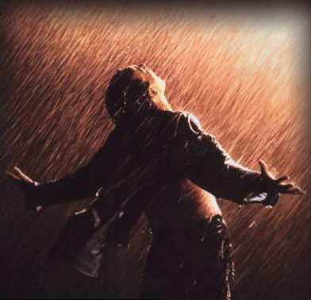
Final Scenes
“I have to remind myself that some birds aren't meant to be caged. Their feathers are just too bright and when they fly away, the part of you that knows it was a sin to lock them up does rejoice, but still, the place you live in is that much more drab and empty that they're gone. I guess I just miss my friend.”

